Slide 1
INTERNATIONAL CONSTRUCTIVISM
The Machine Aesthetic and
The Construction of a New (Rational, Post-War) Society
Dutch De Stijl, Russian Constructivism,
German Bauhaus, French L’Esprit Nouveau

Slide 2
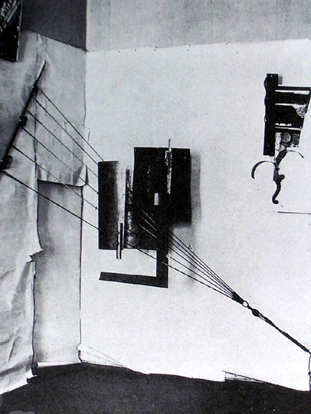
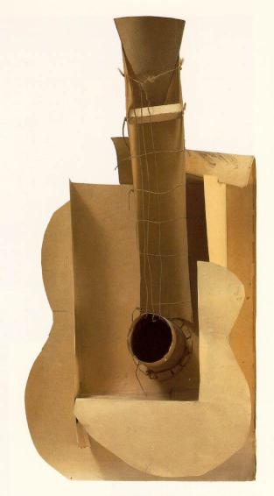
(left) Vladimir Tatlin (Russian, 1895-1953) Counter-Relief, 1915, iron, copper, wood, and rope, 28 x 46” Shown at 0.10: The Last Futurist Exhibition in Petrograd (right) Picasso, Maquette for Guitar, 1912, cardboard, string, and wire, 25 x 13 x 7”

Slide 3
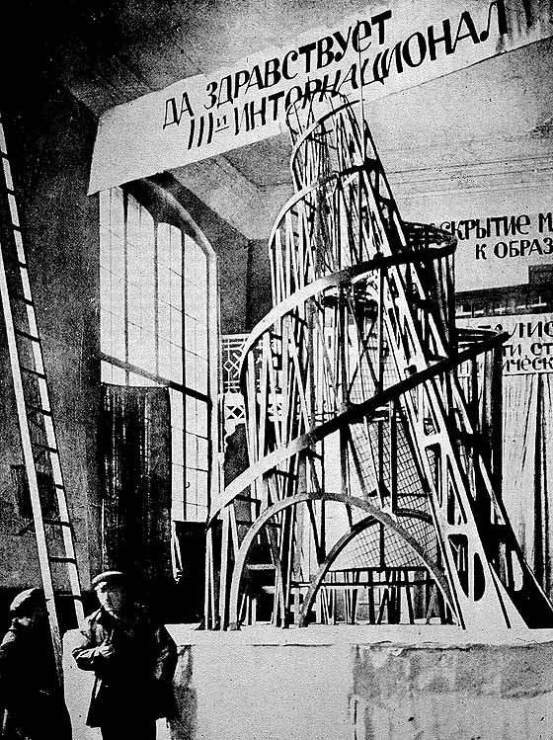
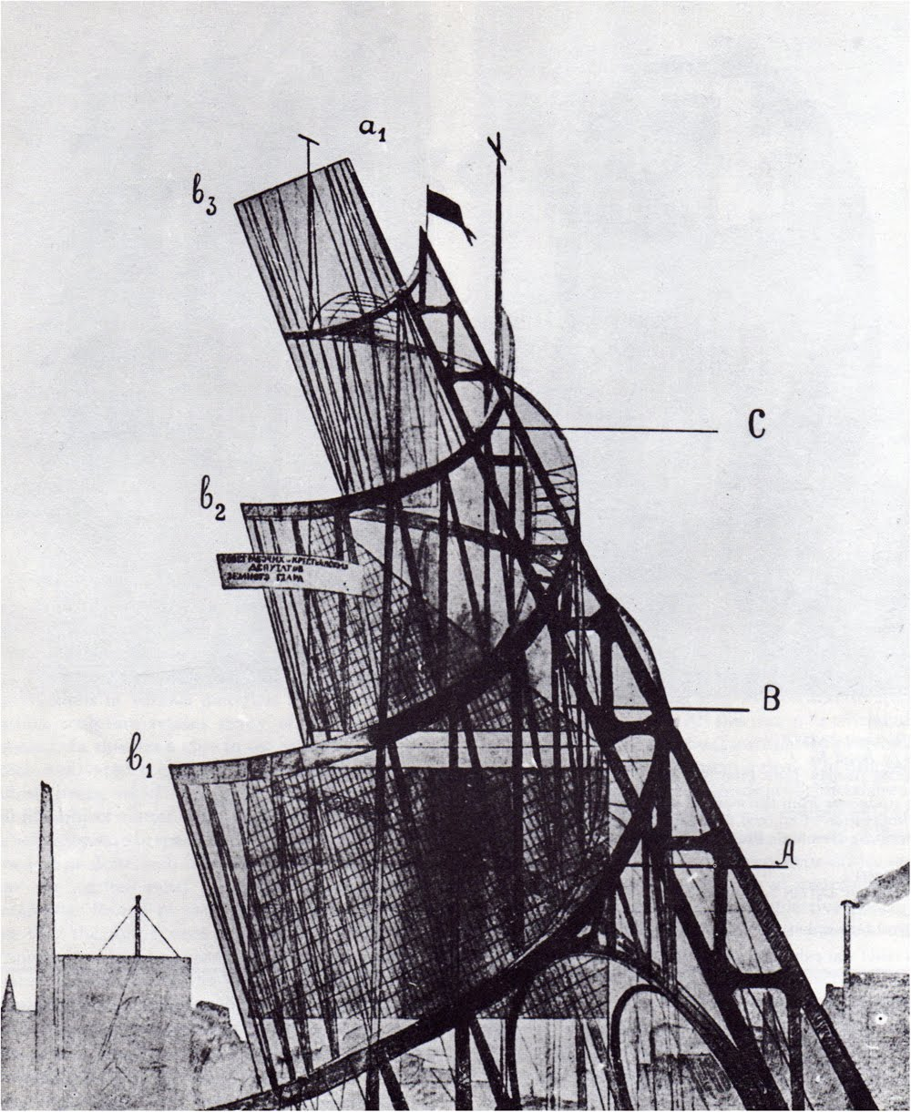
Vladimir Tatlin, Model for Monument to the Third International, 1919-20, wood, iron, and glass, 20’ high.

Slide 4
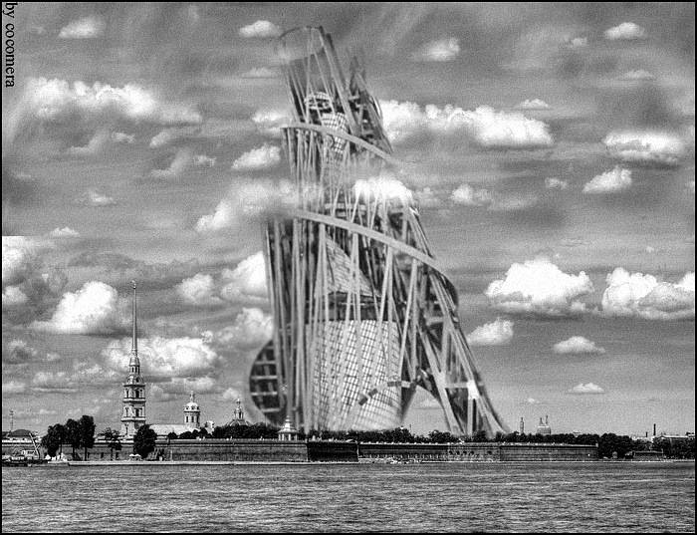
How Tatlin’s Monument to the Third International would have looked had it been built – in Leningrad (now Saint Petersburg) by the Neva river on the route where the first revolutionaries marched toward the Winter Palace.

Slide 5
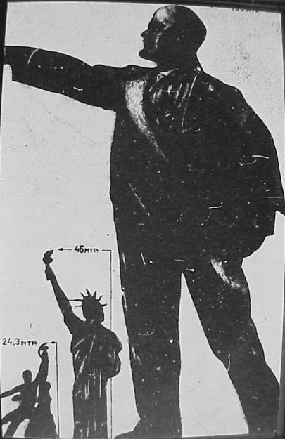
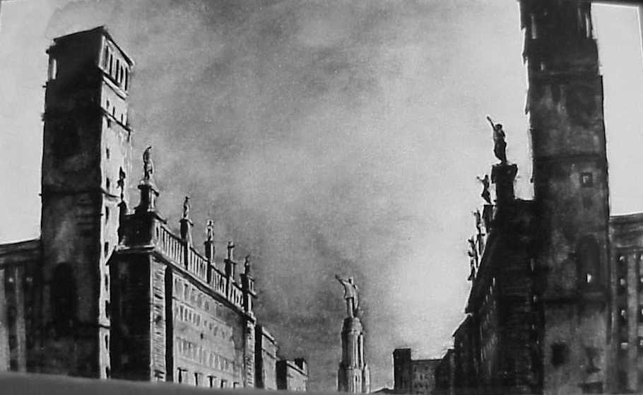
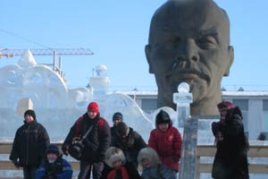
(above) Plan for the Palace of the Soviets, 1935. Totalitarian architecture with colossal statues in Socialist Realist style.
(left) Gigantic head of Lenin in Siberia

Slide 6
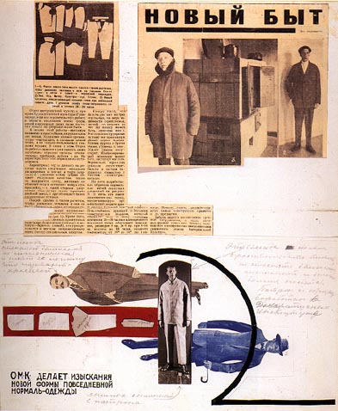
Vladimir Tatlin modeling his design for worker’s clothing / mass production, 1924

Slide 7
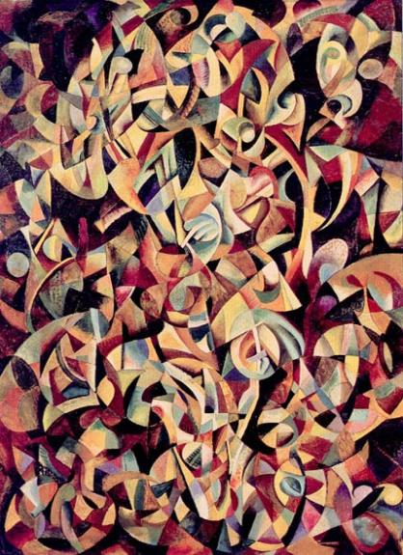
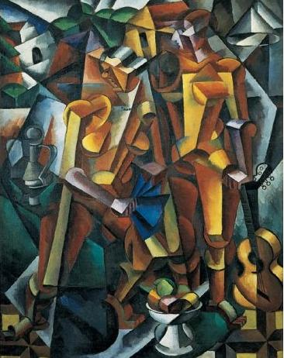
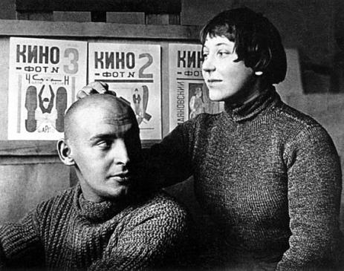
Alexander Rodchenko, Dance, Cubo-Futurist, oil on canvas, 1915
Rodchenko and Stepanova
(lifetime companions), as
“Art Engineers” in the 1920s
Varvara Stepanova, Cubo-Futurist painting, 1915
Varvara Stepanova (Russian, 1894-1958), declared in 1921: “Technique and Industry have confronted art with the problem of construction as an active process and not reflective. The 'sanctity' of a work as a single entity is destroyed. The museum which was the treasury of art is now transformed into an archive.”
* Russian Constructivism was a moral and political attack on painting as the pre-eminent art form of “bourgeois” individualism and capitalism.

Slide 8
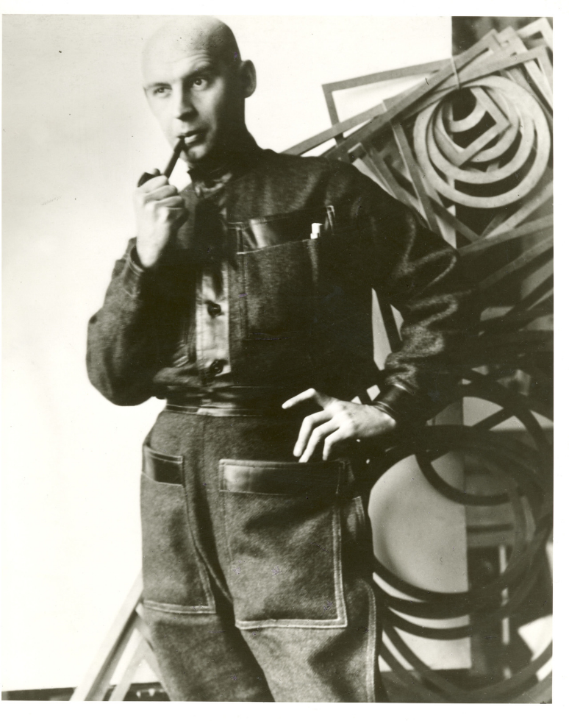
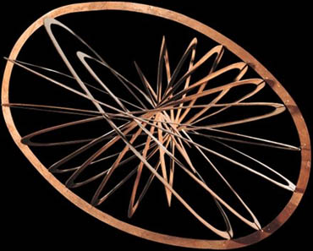
Alexander Rodchenko (Russian, 1891-1956) in “worker’s” outfit sewn (by hand) for him by Stepanova, with his spatial constructions; open on right: Oval Hanging Construction no 12, 1920, plywood, aluminum paint, and wire

Slide 9
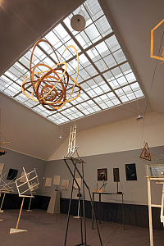
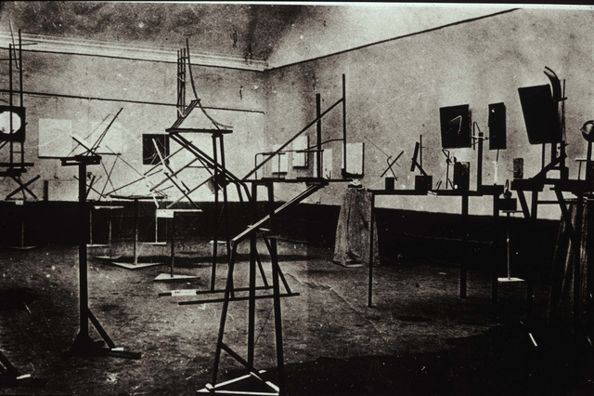
Constructivist exhibition, 1921, Moscow, Obmokhu, acronym for the Society of Young Artists, 1919-22. Photograph by Rodchenko. (right) 2006 reconstruction of the 1921 Constructivist exhibition

Slide 10
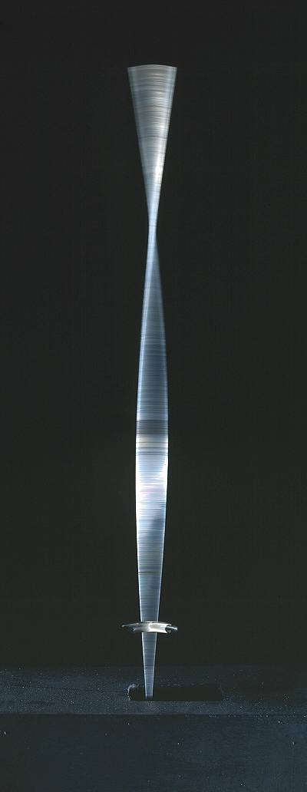
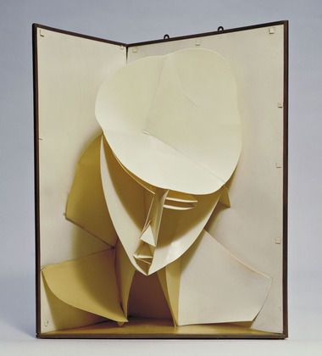
Naum Gabo (US, b. Russia, 1890-1977) (right) Kinetic Construction (Standing Wave) 1919–20 (replica 1985) wood, metal and electric motor. Made to demonstrate the principles of kinetics to his students at Vkhutemas (acronym for “Higher Art and Technical Studios”) in Moscow, an equivalent to German Bauhaus). A strip of metal oscillates so that a standing wave is set up, creating the illusion of volume. Futurist desire for movement and conflation of time and space led Gabo to invent Kinetic sculpture. (Below) Head of a Woman, 1917-20 (after a work of 1916), celluloid and metal, 24 x 19 inches, MoMA NYC

Slide 11
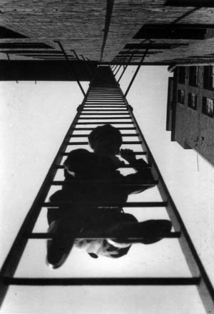
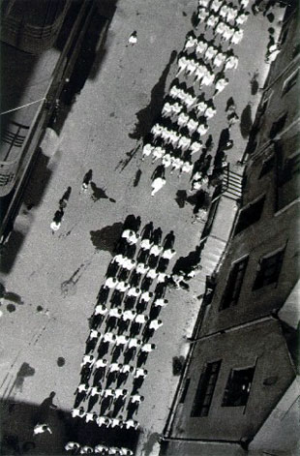
Rodchenko, Demonstration, 1928 (left) and Fire Escape, 1925 (right) Russian Constructivist photography, extreme values (white-black key), radical angles of vision, with emphasis on both abstract form and the urban worker

Slide 12
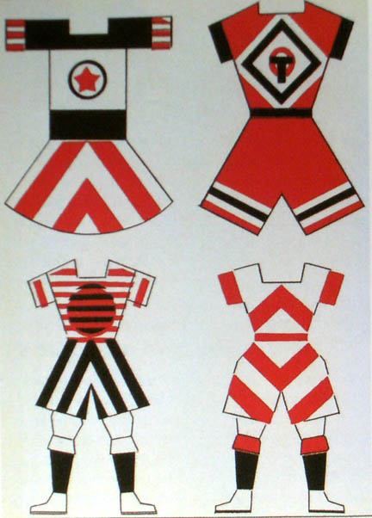
Varvara Stepanova (1894-1958) with her designs for sportswear, both 1923 The “New Woman” and production aesthetics

Slide 13
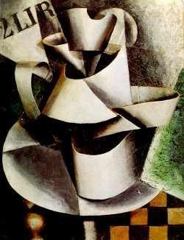
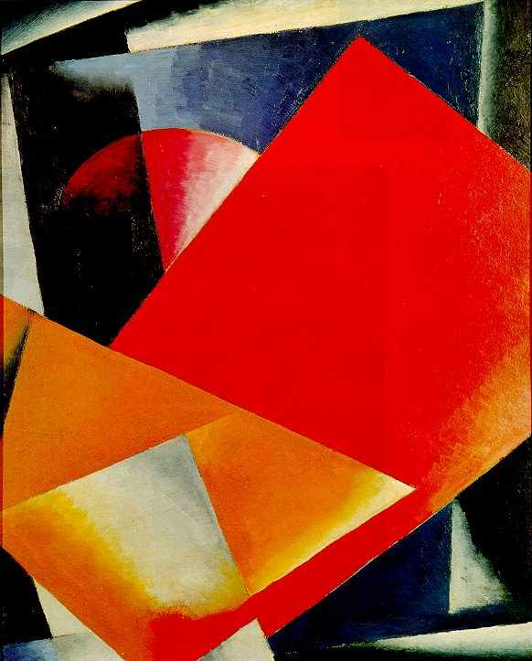
Lyubov Popova (1889-1924), pre-revolutionary paintings: (left) Jug on a Table, 1915; (right) Painterly Architectonics, 1916-8

Slide 14
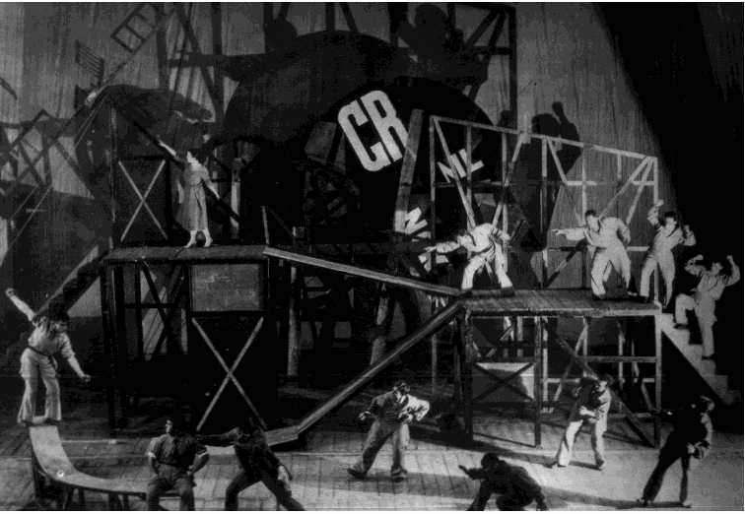
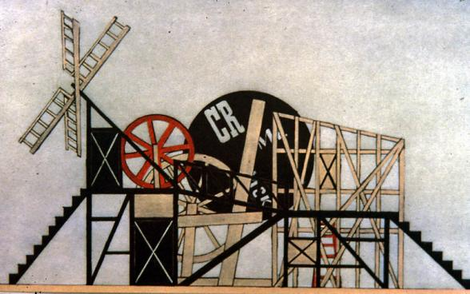
Russian Constructivist theater Lyubov Popova, stage design for Meyerhold’s production of Fernand Crommelynck's (1921) play, The Magnanimous Cuckold, 1922

Slide 15
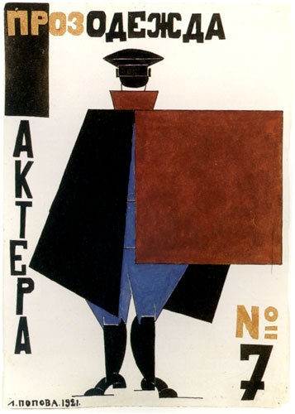
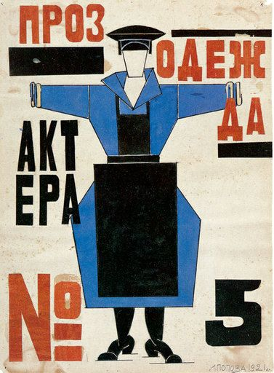
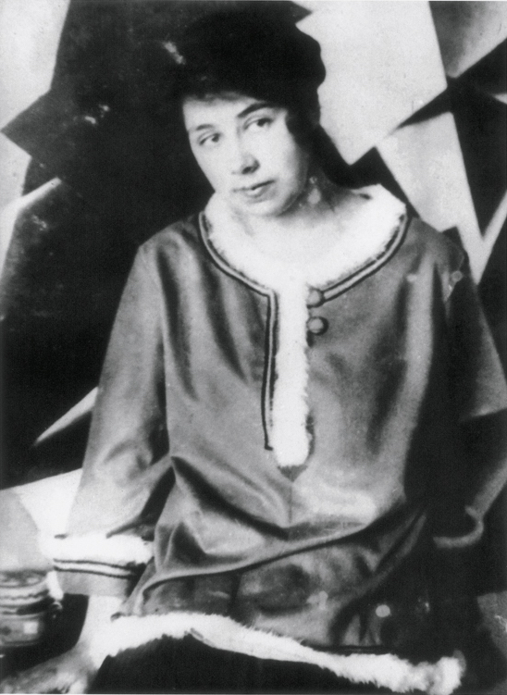
Lyubov Popova’s costume designs for “Actor #7” and “Worker” “Actor #5” anonymous players in The Magnanimous Cuckold, 1922

Slide 16
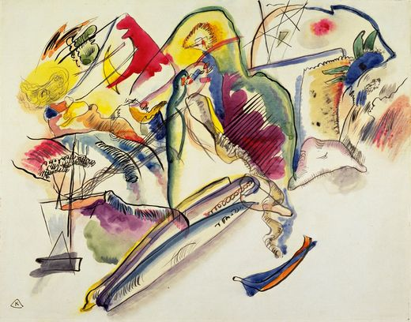
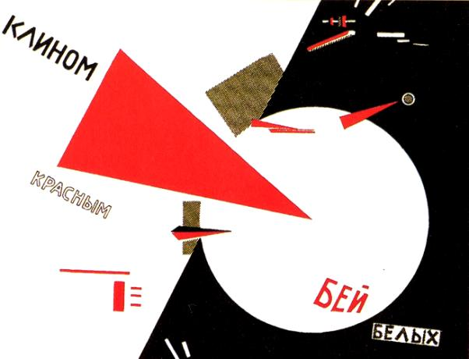
Constructivist rationalist “factura” versus Expressionist line: “The inaccurate, trembling line traced by the hand cannot compare with the straight and precise line drawn with the set square, reproducing the design exactly. Handcrafted work will have to try to be more industrial. Drawing as it was conceived in the past loses its value and is transformed into diagram or geometrical projection." - Rodchenko (left) Wassily Kandinsky, Watercolor (Number 13), 1913 (expressive line) (right) El (Eleazar) Lissitzky (Russian, 1890-1941), Beat the Whites with the Red Wedge, 1919-20 (analytic line = “rationalism” of the machine)

Slide 17
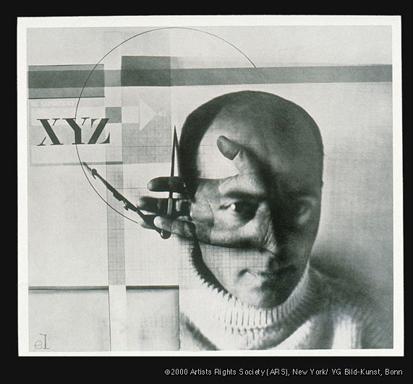
El Lissitzky, Russian artist, designer, photographer, typographer, polemicist and architect. The Constructor (Self-Portrait), 1924, gelatin-silver print, double exposure

Slide 18
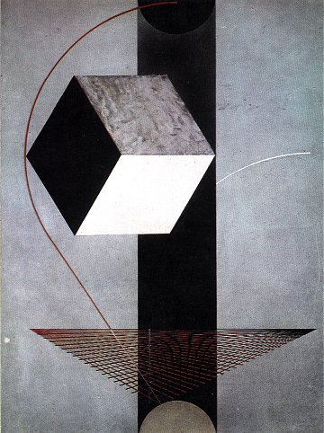
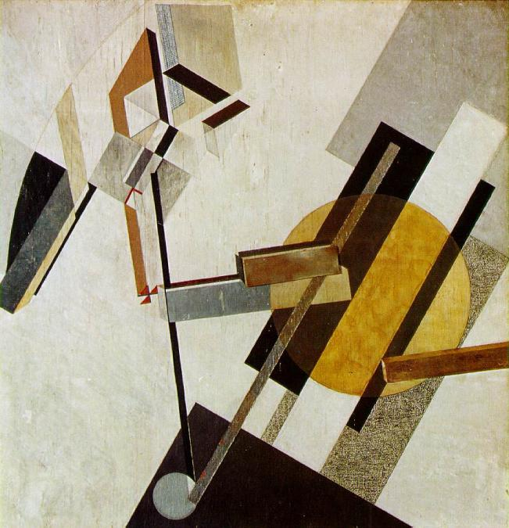
(left) Lissitzky, Proun 19d, c. 1922, gesso, oil and collage on wood 38 x 38” (right) Lissitzky, Construction 99 (Proun 99), 1924-25, oil on wood, 50 x 38” PROUN (an acronym for “project for the affirmation of the new” in Russian, "the station where one changes from painting to architecture."

Slide 19
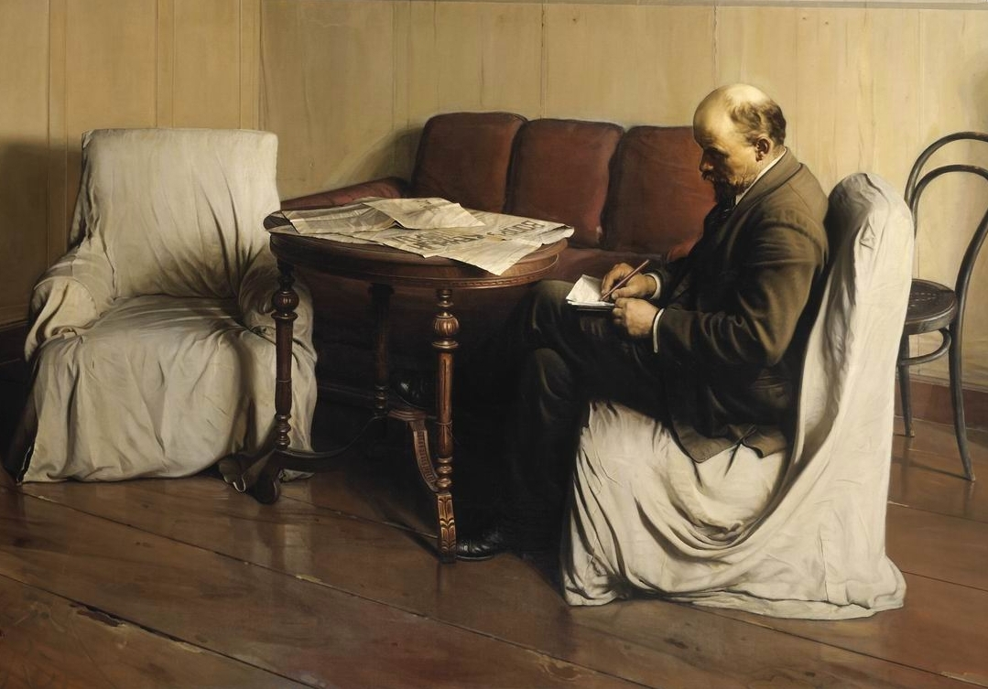
Soviet Socialist Realism: the “other” Communist art Isaak Brodsky (Russian, 1884-1939), V.I. Lenin at Smolny, 1930

Slide 20
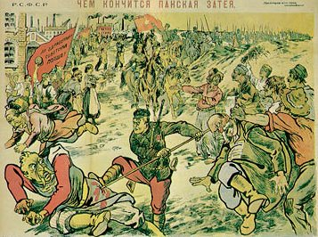
(left) El Lissitzky Beat the Whites with the Red Wedge, 1919-20 (Civil War,1917-1921) (right) Soviet propaganda poster featuring the destruction of White Poland, 1919
Russian Constructivism failed to communicate to the people.

Slide 21
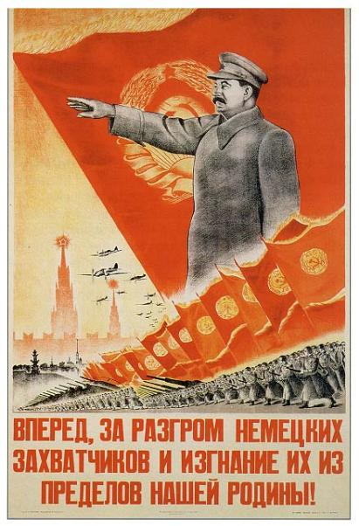
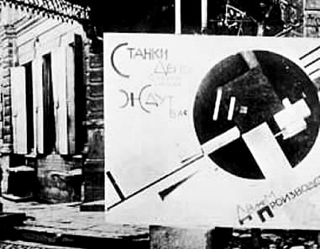
El Lissitzky, (left) agit-prop panel photographed on the streets of Vitebsk in 1920, reads: "The Machine tool depots of the factories and plants await you. Let's get industry moving." Compare with WW II Stalinist propaganda poster: “Stalin leads”

Slide 22
The Bauhaus German Constructivism 1919-1933

Slide 23
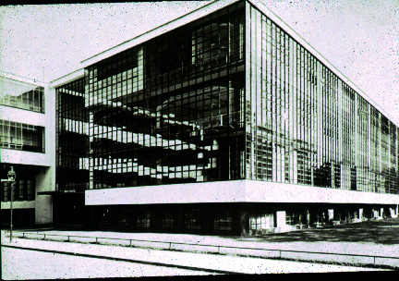
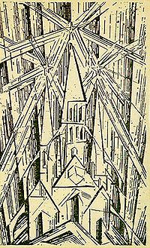
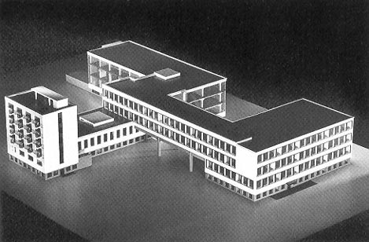
(left top and bottom) Walter Gropius (German, 1883-1969) Bauhaus, Dessau, Germany, 1925, utilizes industrial materials, technologies and style: machine aesthetic. (right) Lyonel Feininger (American-born German Cubist/Expressionist Painter, 1871-1956), Cathedral of Socialism, wood-cut for the Bauhaus Manifesto, 1919: craft /expressionist aesthetic.
In 1923 the school slogan was changed from “A Cathedral of Socialism” based on the Medieval cathedral workshop (bauhaus) to “Art and Technology – A New Unity” based on the machine-production-industrial aesthetic

Slide 24
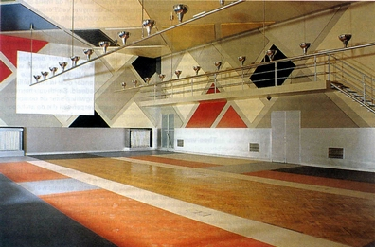
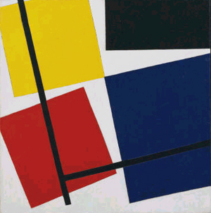
(left) Theo van Doesburg, Sophie Taeuber, and Jean Arp, De Stijl “Elementarist” interior, Café Aubette, Strasbourg, 1926-28 (destroyed 1940) 1994 restoration (right) Doesburg, Simultaneous Counter-Composition. (1929–30), oil on canvas, 19 3/4 x 19 5/8" Doesburg visited Weimar in 1921, moved there in 1922 and taught at the Weimar Bauhaus.
“Countless ideas produced by modern painting once it shed its old constraints now lie fallow, awaiting their implementation in the trades.”
- Walter Gropius,1923

Slide 25
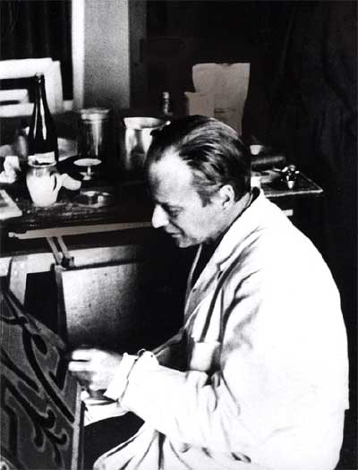
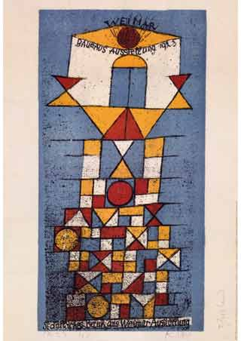
Paul Klee in Bauhaus (Weimar) studio, 1922; (right) Klee, Sublime Site Bauhaus, advertising poster for the Bauhaus, 1923. Klee stayed with the Bauhaus until 1933 when it was closed by the new National Socialist (Nazi) government, and he returned to Switzerland. Wassily Kandinsky was also among the Bauhaus workshop masters.

Slide 26
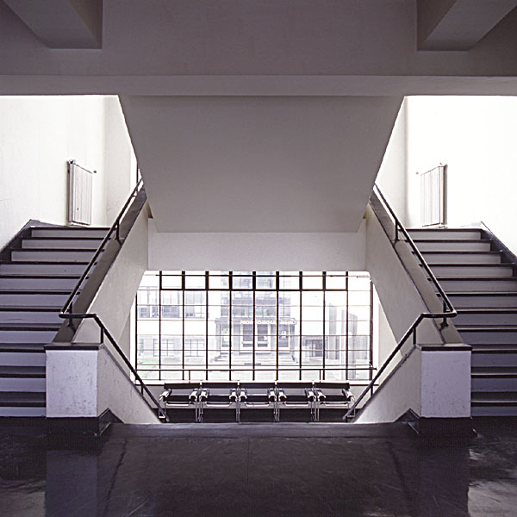
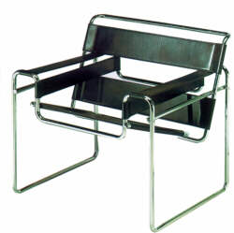
(left) Marcel Breuer (Hungarian, 1902 -1981), Wassily Chair (made for Kandinsky) 1925, tubular bent steel, modular; (right) Bauhaus Steps, current restoration view. Breuer and Walter Gropius both immigrated to the United States during WW II to teach art at Harvard.

Slide 27
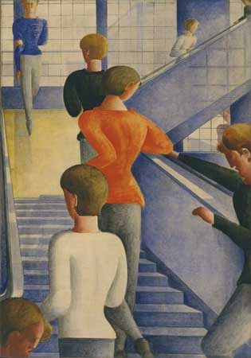
Oskar Schlemmer (German, 1888-1943) Bauhaus Stairway, 1932, oil on canvas, 64 x 45.“ Schlemmer was Master of the Bauhaus 3-D workshop

Slide 28
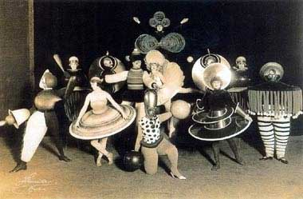
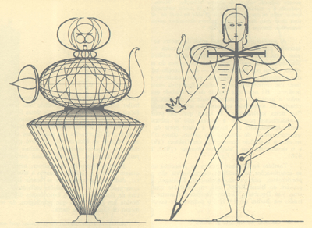
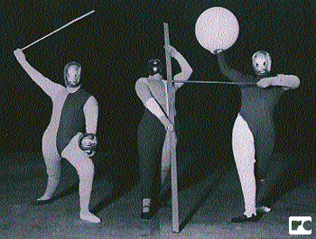
Oskar Schlemmer, Triadic Ballet costumes, 1926 with (right) Schlemmer’s diagrammatic analysis of form: the human body-machine-sculpture
http://www.rolandcollection.com/home.aspx#D136
Man and Mask Ballet

Slide 29
László Moholy-Nagy (Hungarian photographer, typographer, sculptor, painter, printmaker, and industrial designer, 1895-1946) (left) Balance study, 1924, wood and metal (center) László Moholy-Nagy and Lucia Moholy, Portrait of Moholy-Nagy, 1932 (right) Moholy-Nagy, AXXV, oil on canvas,1926
Moholy-Nagy, Bauhaus master
replaced Johannes Itten as the
instructor of the preliminary course
in 1923

Slide 30
(left) Moholy-Nagy, Bauhaus Balcony, 1926 (right) Rodchenko, Gathering for the demonstration in the courtyard of the VChUTEMAS (Higher Institute of Technics and Art), 1928 Constructivist photographs of Constructivist schools

Slide 31
Moholy-Nagy and students in Bauhaus metal design workshop, 1926, including Marianne Brandt (below right), designer of ceiling lamp (right), 1926, Dessau Bauhaus
“…Derive the design of an object
from [its] natural functions and
conditions." Walter Gropius, 1925

Slide 32
L’Esprit Nouveau (Paris-based Constructivism) Le Corbusier (b. Charles-Edouard Jeanneret, Swiss,1887-1965)
Paris-based magazine 1920-25
(28 issues) founded by Jenneret and Amédée Ozanfant where Le Corbusier
published his famous theoretical essays.
Le Corbusier 1928 chaise longue

Slide 33
(left) Amédée Ozenfant (French painter and architect,1886 -1966), Guitar and Bottles, Purism; (right) Le Corbusier, Vertical Still Life, 1922, Purism Ozenfant and Le Corbusier formulated Purism in their book, After Cubism, 1918, a few days after the signing of the armistice of WWI, which the authors believed made Purism a necessary “return to order.”
Machine aesthetics and classical, pure proportion in painting is
the foundation of modern architecture

Slide 34
Pages from L’Esprit Nouveau, 1921 & 1922 Manifesto of Purism: “Logic, born of human constants and without which nothing is human . . . . One of the highest delights of the human mind is to perceive the order of nature and to measure its own participation in the scheme of things; the work of art seems to us to be a labor of putting into order, a masterpiece of human order . . .

Slide 35
Fernand Léger,
The Mechanic, 1919
L’Esprit Nouveau Purism -
Machine aesthetic

Slide 36
(Right, top and bottom) Le Corbusier, Contemporary City of 3 Million Inhabitants (Plan for Paris), 1922. Modernist urban utopias, beginning and end. Corbusier’s plan will devolve into efficiency “projects” and urban centers of the post WW II decades worldwide.
Urban renewal of Paris by
Napoleon III, 1860s; Monet,
Blvd. des Capucines, 1873

Slide 37
Pruitt-Igoe, the 1951 public housing project in St. Louis by architect Minoru Yamasaki, demolished in 1972. “The End” of modern architecture?

Slide 38
Le Corbusier, Villa Savoye, 1929-30, Poissy-sur-Seine, near Paris, exterior views. Commissioned by the Savoye family as a summer home
“A machine for living”
- Corbusier
Five design principles: raised ground floor, wide windows, roof terraces, open facades, and open plans, all made possible by the new material, reinforced concrete.

Slide 39
'Until now: load-bearing walls; from the ground they are superimposed, forming the ground floor and the upper stories, up to the eaves. The layout is a slave to the supporting walls. Reinforced concrete in the house provides a free plan! The floors are no longer superimposed by partition walls. They are free.‘ - Le Corbusier
Villa Savoye, interior views

